Slide 1
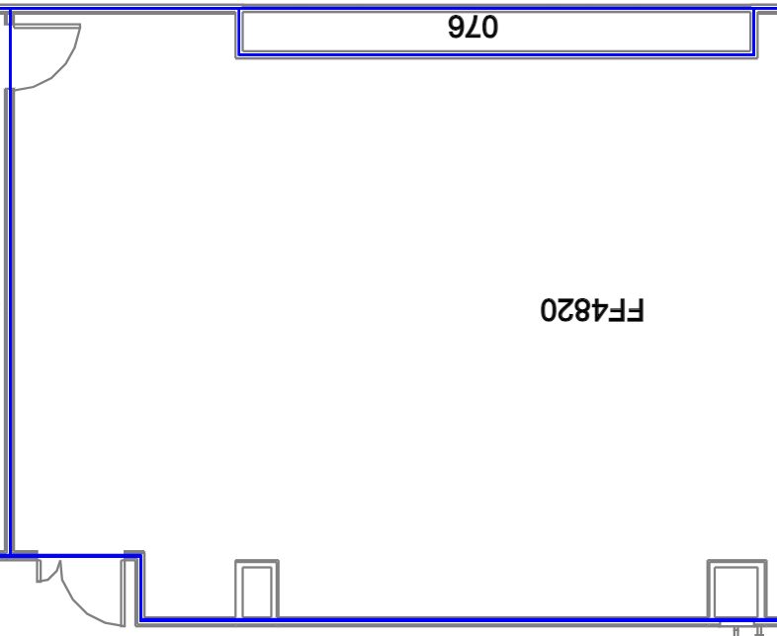
INC-84
Leps
I3213
NBSB rearing and handling
INC-112
WCR
INC-113
WTP, CPB, MBB Storage
FRZ-365
working
I840
?
INC-93
Leps
I3413
Rootworm Handling
FRZ-248
Weekday Disposal
FRZ-342
Working
DC samples
I1601
empty
INC-94
Leps
INC-63
Leps
F3212
Weekday Disposal
FRZ-335
Long-term storage
I2377
Monarch
INC-92
Leps
INC-71
GLW bioassay
F3584
Working
FRZ-343
Chemicals
INC-120
OOO
I1383
PWA
INC-90
SCR
FRZ-220
Working
I1112
Lep/
rootwormreceiving
FRZ-352
PM freezer
FRZ-353
Buffer Freezer
INC-111
Leps
R2192
Buffers

Slide 2
INC-84
Leps
I3213
WCR
INC-112
Monarch
INC-113
Cold storage
FRZ-365
I840
GLW
INC-93
MBB assays
I3413
Pollen Germ
FRZ-248
Elsa
FRZ-342
workingDC
I1601
WCR/SCR Rearing
INC-94
CFF
INC-63
NBSB Rearing
F3212
Anna
FRZ-335
Long-term
I2377
BEB rearing
INC-92
Leps
INC-71
NBS Assay
F3584
working
FRZ-343
chemicals
I2378
OOO
I1383
Corn Roots
INC-90
SCR
FRZ-220
working
I1112
Lep/rootworm receiving
FRZ-352
PM freezer
FRZ-353
Buffer/working
INC-111
Corn Rolls
R2192
Buffers

Slide 3
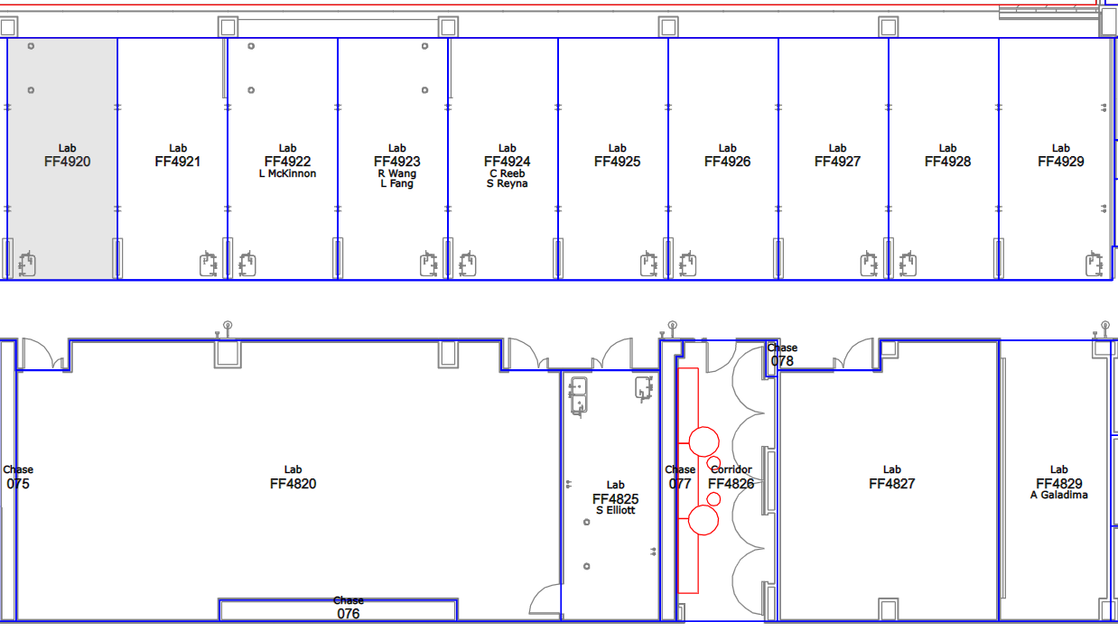
32
30
31
29
28
27
26
25
21
15
10
5
1
22
16
11
6
2
17
12
7
3
23
Washroom
18
13
8
4
24
19/20
14
9

Slide 4
 |  | INC-84 Temp:27°C ± 5°C; RH: 60% ± 10%; 14 Light: 10 Dark S/N#:26725.01.19D; Node:3; Input:87/88 (temp/RH)-Rees System | I3213 Lep/Cbp/mbb Bioassays Temp:27°C ± 5°C; RH: 60% ± 10%; 14 Light: 10 Dark S/N#:17204.01.12F; Node:3; Input:85/86 (temp/RH)-Rees System
I840 Cricket Temp:25°C ± 5°C; RH: 70% ± 10% 16:8 L:D S/N#:3966.02.02I Node:3; Input:103/104(temp/RH)-Rees System |  | Inc 93 ; Aquatic NTO Temp:23°C ± 5°C; RH: 60% ± 10%; 16 Light: 8 Dark S/N#:29748.03.21; Node:3; Input:89/90(temp/RH)-Rees System | I3413 TEMP SCR Temp:27°C ± 5°C; RH: 70% ± 10%; 24 Dark S/N#:18810.01.13H; Node:3; Input:83/84 (temp/RH)-Rees System
I1601 SCR/WCR Handling Temp:25°C ± 5°C; RH: 70% ± 10%; 24 hrs Dark S/N#:8904.01.06C; Node:3; Input:102/101 (temp/RH)-Rees System |  | Inc 94 Drosophila Temp:25°C ± 5°C; RH: 70% ± 10%; 14 light:10 dark S/N#:29748.02.21; Node:3; Input:91/92 (temp/RH)-Rees System | INC-63 WCR bioassays Temp:25°C ± 5°C; RH: 70% ± 10%; 24 hrs Dark S/N#:21725.01.15H; Node:3; Input:81/82 (temp/RH)-Rees System
I2377 Geocoris RB Temp:27°C ± 5°C; RH: 50% ± 10%; 14 Light: 10 Dark S/N#:13241.01.09H; Node:3; Input:99/100 (temp/RH)-Rees System |  | INC-92 Temp:27C ± 5°C; RH: 60% ± 10%; 14 Light: 10 Dark S/N#:29748.01.21; Node:3; Input:93/94 (temp/RH)-Rees System | INC-71 WCR bioassays Temp:25°C ± 5°C; RH: 70% ± 10%; 24 hrs Dark S/N#:24447.01.17F; Node:3; Input:79/80 (temp/RH)-Rees System
I2378 Parasitic Wasp Temp:25°C ± 5°C; RH: 70% ± 10%; 14 Light: 10 Dark S/N#:13241.02.09H; Node:3; Input:97/98 (temp/RH)-Rees System
I2378 Nabis RB Temp:27°C ± 5°C; RH: 60% ± 10%; 14 Light: 10 Dark S/N#:13241.02.09H; Node:3; Input:97/98 (temp/RH)-Rees System |  | I1383 Lygus lineolaris Temp:27°C ± 5°C; RH: 60% ± 10%; 14 Light: 10 Dark S/N#:749.01.05J; Node:3; Input:95/96 (temp/RH)-Rees System | INC-90 SCR Temp:27°C ± 5°C; RH: 70% ± 10%; 24 Dark S/N#:28648.01.20G; Node:3; Input:77/78 (temp/RH)-Rees System
 |  |  | FRZ-248 Disposal Freezer Temp:-20°C ± 10°C; S/N#:VWR 48JO467-1810; Node:3; Input:76 (temp)-Rees System
 |  |  | F3212 Chemical/Diet Storage Temp:-20°C ± 10°C; S/N#:0116927301120713; Node:3; Input:75 (temp)-Rees System
 |  |  | F3584 Sample Storage Temp:-80°C ± 10°C; S/N#:14050055; Node:3; Input:74 (temp)-Rees System
 |  |  | FRZ-220 Sample Storage Temp:-80°C ± 10°C; S/N#:16110354; Node:3; Input:73 (temp)-Rees System
I1121 WTP; CPB; MBB 15°C ± 5°C; RH: Ambient; 24 hrs Dark S/N#:3966.01.02I; Node:3; Input:107 (temp)-Rees System | I1112 Leps and Rootworm 10°C ± 5°C; RH: Ambient; 24 hrs Dark S/N#:99-006; Node:3; Input:108 (temp)-Rees System | I1112 Leps and Rootworm 10°C ± 5°C; RH: Ambient; 24 hrs Dark S/N#:99-006; Node:3; Input:108 (temp)-Rees System | INC-111 Parasitic Wasp Temp:25°C ± 5°C; RH: 70% ± 10%; 14 Light: 10 Dark S/N#:7306-22-1-026P Node3 Input: 109/ 110 (temp/humidity) | R2192 Chemical/Buffer Storage Temp:4°C ± 5°C; S/N#:U08T-135836-UT; Node:3; Input:72 (temp)-Rees System
Updated: 9/28/2022
FRZ-316 Storage Freezer FF4800 Temp: -80 + 10 - 20 S/N#: 1116144001210511 Input: 2 (temp) –REES System

Slide 5
 |  | INC-84 Temp:27°C ± 5°C; RH: 60% ± 10%; 14 Light: 10 Dark S/N#:26725.01.19D; Node:3; Input:87/88 (temp/RH)-Rees System | I3213 Lep/Cbp/mbb Bioassays Temp:27°C ± 5°C; RH: 60% ± 10%; 14 Light: 10 Dark S/N#:17204.01.12F; Node:3; Input:85/86 (temp/RH)-Rees System
I840 Cricket Temp:25°C ± 5°C; RH: 70% ± 10% 16:8 L:D S/N#:3966.02.02I Node:3; Input:103/104(temp/RH)-Rees System |  | Inc 93 ; Ground beetle Temp:27°C ± 5°C; RH: 70% ± 10%; 16 Light: 8 Dark S/N#:29748.03.21; Node:3; Input:89/90(temp)-Rees System | I3413 TEMP SCR Temp:27°C ± 5°C; RH: 70% ± 10%; 24 Dark S/N#:18810.01.13H; Node:3; Input:83/84 (temp/RH)-Rees System
I1601 SCR/WCR Handling Temp:25°C ± 5°C; RH: 70% ± 10%; 24 hrs Dark S/N#:8904.01.06C; Node:3; Input:102/101 (temp/RH)-Rees System |  | Inc 94 Drosophila Temp:25°C ± 5°C; RH: 70% ± 10%; 14 light:10 dark S/N#:29748.02.21; Node:3; Input:91/92 (temp/RH)-Rees System | INC-63 WCR bioassays Temp:25°C ± 5°C; RH: 70% ± 10%; 24 hrs Dark S/N#:21725.01.15H; Node:3; Input:81/82 (temp/RH)-Rees System
I2377 Geocoris RB Temp:27°C ± 5°C; RH: 50% ± 10%; 14 Light: 10 Dark S/N#:13241.01.09H; Node:3; Input:99/100 (temp/RH)-Rees System |  | INC-92 Temp:27C ± 5°C; RH: 60% ± 10%; 14 Light: 10 Dark S/N#:29748.01.21; Node:3; Input:93/94 (temp/RH)-Rees System | INC-71 WCR bioassays Temp:25°C ± 5°C; RH: 70% ± 10%; 24 hrs Dark S/N#:24447.01.17F; Node:3; Input:79/80 (temp/RH)-Rees System
I2378 Nabis RB Temp:25°C ± 5°C; RH: 70% ± 10%; 14 Light: 10 Dark S/N#:13241.02.09H; Node:3; Input:97/98 (temp/RH)-Rees System
I2378 Nabis RB Temp:27°C ± 5°C; RH: 60% ± 10%; 14 Light: 10 Dark S/N#:13241.02.09H; Node:3; Input:97/98 (temp/RH)-Rees System |  | I1383 Lygus lineolaris Temp:27°C ± 5°C; RH: 80% ± 10%; 14 Light: 10 Dark S/N#:749.01.05J; Node:3; Input:95/96 (temp/RH)-Rees System | INC-90 SCR Temp:27°C ± 5°C; RH: 70% ± 10%; 24 Dark S/N#:28648.01.20G; Node:3; Input:77/78 (temp/RH)-Rees System
FRZ-316 Storage Freezer Temp: -80 + 10 - 20 S/N#: 1116144001210511 Input: 2 (temp) –REES System
 |  | FRZ-248 Disposal Freezer Temp:-20°C ± 10°C; S/N#:VWR 48JO467-1810; Node:3; Input:76 (temp)-Rees System
 |  | F3212 Chemical/Diet Storage Temp:-20°C ± 10°C; S/N#:0116927301120713; Node:3; Input:75 (temp)-Rees System
 |  | F3584 Sample Storage Temp:-80°C ± 10°C; S/N#:14050055; Node:3; Input:74 (temp)-Rees System
 |  | FRZ-220 Sample Storage Temp:-80°C ± 10°C; S/N#:16110354; Node:3; Input:73 (temp)-Rees System
I1121 WTP; CPB; MBB 15°C ± 5°C; RH: Ambient; 24 hrs Dark S/N#:3966.01.02I; Node:3; Input:107 (temp)-Rees System | I1112 Leps and Rootworm 10°C ± 5°C; RH: Ambient; 24 hrs Dark S/N#:99-006; Node:3; Input:108 (temp)-Rees System | R2192 Chemical/Buffer Storage Temp:4°C ± 5°C; S/N#:U08T-135836-UT; Node:3; Input:72 (temp)-Rees System
Updated: 8/3/2022

Slide 6
 |  | INC-84 Temp:25°C ± 5°C; RH: 70% ± 10%; 14 Light: 10 Dark S/N#:26725.01.19D; Node:3; Input:87/88 (temp/RH)-Rees System | I3213 Lep/Cbp/mbb Bioassays Temp:27°C ± 5°C; RH: 60% ± 10%; 14 Light: 10 Dark S/N#:17204.01.12F; Node:3; Input:85/86 (temp/RH)-Rees System
I840 Cold Storage Temp:10°C ± 5°C; RH: Ambient 24 hrs Dark S/N#:3966.02.02I Node:3; Input:103(temp)-Rees System |  | Inc 93 ; Ground beetle Temp:25°C ± 5°C; RH: 70% ± 10%; 16 Light: 8 Dark S/N#:29748.03.21; Node:3; Input:89/90(temp)-Rees System | I3413 TEMP SCR Temp:27°C ± 5°C; RH: 60% ± 10%; 14 Light: 10 Dark S/N#:18810.01.13H; Node:3; Input:83/84 (temp/RH)-Rees System
I1601 SCR/WCR Handling Temp:25°C ± 5°C; RH: 70% ± 10%; 24 hrs Dark S/N#:8904.01.06C; Node:3; Input:101/102 (temp/RH)-Rees System |  | Inc 94 Drosophila Temp:27°C ± 5°C; RH: 60% ± 10%; 14 light:10 dark S/N#:29748.02.21; Node:3; Input:91/92 (temp/RH)-Rees System | INC-63 WCR bioassays Temp:25°C ± 5°C; RH: 70% ± 10%; 24 hrs Dark S/N#:21725.01.15H; Node:3; Input:81/82 (temp/RH)-Rees System
I2377 Geocoris RB Temp:27°C ± 5°C; RH: 50% ± 10%; 14 Light: 10 Dark S/N#:13241.01.09H; Node:3; Input:99/100 (temp/RH)-Rees System |  | INC-92 Temp:25C ± 5°C; RH: 70% ± 10%; 14 Light: 10 Dark S/N#:29748.01.21; Node:3; Input:93/94 (temp/RH)-Rees System | INC-71 WCR bioassays Temp:25°C ± 5°C; RH: 70% ± 10%; 24 hrs Dark S/N#:24447.01.17F; Node:3; Input:79/80 (temp/RH)-Rees System
I2378 Nabis RB Temp:27°C ± 5°C; RH: 60% ± 10%; 14 Light: 10 Dark S/N#:13241.02.09H; Node:3; Input:97/98 (temp/RH)-Rees System |  | I1383 Lygus lineolaris Temp:27°C ± 5°C; RH: 80% ± 10%; 14 Light: 10 Dark S/N#:749.01.05J; Node:3; Input:95/96 (temp/RH)-Rees System | INC-90 SCR Temp:27°C ± 5°C; RH: 70% ± 10%; 14 light:10 dark S/N#:28648.01.20G; Node:3; Input:77/78 (temp/RH)-Rees System
 | FRZ-316 Storage Freezer Temp: -80 S/N#: 1116144001210511 Input: 2 (temp) –REES System |  | FRZ-248 Disposal Freezer Temp:-20°C ± 10°C; S/N#:VWR 48JO467-1810; Node:3; Input:70 (temp)-Rees System
 |  |  | F3212 Chemical/Diet Storage Temp:-20°C ± 10°C; S/N#:0116927301120713; Node:3; Input:75 (temp)-Rees System
 |  |  | F3584 Sample Storage Temp:-80°C ± 10°C; S/N#:14050055; Node:3; Input:74 (temp)-Rees System
 |  |  | FRZ-220 Sample Storage Temp:-80°C ± 10°C; S/N#:16110354; Node:3; Input:73 (temp)-Rees System
I1112 WTP; CPB; MBB 15°C ± 5°C; RH: Ambient; 24 hrs Dark S/N#:3966.01.02I; Node:3; Input:108 (temp)-Rees System |  | I1121 Storage WTP; CPB; MBB 15°C ± 5°C; RH: Ambient; 24 hrs Dark S/N#:99-006; Node:3; Input:XXX (temp)-Rees System | R2192 Chemical/Buffer Storage Temp:4°C ± 5°C; S/N#:U08T-135836-UT; Node:3; Input:72 (temp)-Rees System
Updated: 11/11/2021

Slide 7
 |  |  | I3213 Lep Bioassays Temp:27°C ± 5°C; RH: 60% ± 10%; 14 Light: 10 Dark S/N#:17204.01.12F; Node:3; Input:85/86 (temp/RH)-Rees System
I840 Cold Storage Temp:10°C ± 5°C; RH: Ambient 24 hrs Dark S/N#:3966.02.02I Node:3; Input:103(temp)-Rees System |  | Inc 93 ; Temp:25°C ± 5°C; RH: 70% ± 10%; 16 Light: 8 Dark S/N#:29748.03.21; Node:3; Input:89/90(temp)-Rees System | I3413 TEMP SCR Temp:27°C ± 5°C; RH: 60% ± 10%; 14 Light: 10 Dark S/N#:18810.01.13H; Node:3; Input:83/84 (temp/RH)-Rees System
I1601 SCR/WCR Handling Temp:25°C ± 5°C; RH: 70% ± 10%; 24 hrs Dark S/N#:8904.01.06C; Node:3; Input:101/102 (temp/RH)-Rees System |  | Inc 94 Temp:27°C ± 5°C; RH: 60% ± 10%; 14 light:10 dark S/N#:29748.02.21; Node:3; Input:91/92 (temp/RH)-Rees System | INC-63 WCR bioassays Temp:25°C ± 5°C; RH: 70% ± 10%; 24 hrs Dark S/N#:21725.01.15H; Node:3; Input:81/82 (temp/RH)-Rees System
I2377 Geocoris RB Temp:27°C ± 5°C; RH: 50% ± 10%; 14 Light: 10 Dark S/N#:13241.01.09H; Node:3; Input:99/100 (temp/RH)-Rees System |  | INC-92 Temp:25C ± 5°C; RH: 70% ± 10%; 14 Light: 10 Dark S/N#:29748.01.21; Node:3; Input:93/94 (temp/RH)-Rees System | INC-71 WCR bioassays Temp:25°C ± 5°C; RH: 70% ± 10%; 24 hrs Dark S/N#:24447.01.17F; Node:3; Input:79/80 (temp/RH)-Rees System
I2378 Nabis RB Temp:27°C ± 5°C; RH: 60% ± 10%; 14 Light: 10 Dark S/N#:13241.02.09H; Node:3; Input:97/98 (temp/RH)-Rees System |  | I1383 Thrips RB Temp:27°C ± 5°C; RH: 80% ± 10%; 14 Light: 10 Dark S/N#:749.01.05J; Node:3; Input:95/96 (temp/RH)-Rees System | INC-90 INSECT HANDLING Temp:27°C ± 5°C; RH: 70% ± 10%; 14 light:10 dark S/N#:28648.01.20G; Node:3; Input:77/78 (temp/RH)-Rees System
 | FRZ-248 Disposal Freezer Temp:-20°C ± 10°C; S/N#:VWR 48JO467-1810; Node:3; Input:70 (temp)-Rees System
 | F3212 Chemical/Diet Storage Temp:-20°C ± 10°C; S/N#:0116927301120713; Node:3; Input:75 (temp)-Rees System
 | F3584 Sample Storage Temp:-80°C ± 10°C; S/N#:14050055; Node:3; Input:74 (temp)-Rees System
 | FRZ-220 Sample Storage Temp:-80°C ± 10°C; S/N#:16110354; Node:3; Input:73 (temp)-Rees System
I1112 WTP; CPB; MBB 15°C ± 5°C; RH: Ambient; 24 hrs Dark S/N#:3966.01.02I; Node:3; Input:108 (temp)-Rees System | R2192 Chemical/Buffer Storage Temp:4°C ± 5°C; S/N#:U08T-135836-UT; Node:3; Input:72 (temp)-Rees System
Updated: 09/20/2021

Slide 8
 |  | INC-84 WASP Temp:25°C ± 5°C; RH: 70% ± 10%; 14 Light: 10 Dark S/N#:26725.01.19D; Node:3; Input:87/88 (temp/RH)-Rees System | I3213 Lep Bioassays Temp:27°C ± 5°C; RH: 60% ± 10%; 14 Light: 10 Dark S/N#:17204.01.12F; Node:3; Input:85/86 (temp/RH)-Rees System
I840 Cold Storage Temp:10°C ± 5°C; RH: Ambient 24 hrs Dark S/N#:3966.02.02I Node:3; Input:103(temp)-Rees System |  | Inc 94 ; Temp:25°C ± 5°C; RH: 70% ± 10%; 16 Light: 8 Dark Node:3; Input:89/90(temp)-Rees System | I3413 TEMP SCR Temp:27°C ± 5°C; RH: 60% ± 10%; 14 Light: 10 Dark S/N#:18810.01.13H; Node:3; Input:83/84 (temp/RH)-Rees System
I1601 SCR/WCR Handling Temp:25°C ± 5°C; RH: 70% ± 10%; 24 hrs Dark S/N#:8904.01.06C; Node:3; Input:101/102 (temp/RH)-Rees System |  | Inc 93 Temp:27°C ± 5°C; RH: 60% ± 10%; 14 light:10 dark S/N#:3966.01.02I; Node:3; Input:91/92 (temp/RH)-Rees System | INC-63 WCR bioassays Temp:25°C ± 5°C; RH: 70% ± 10%; 24 hrs Dark S/N#:21725.01.15H; Node:3; Input:81/82 (temp/RH)-Rees System
I2377 Geocoris RB Temp:27°C ± 5°C; RH: 50% ± 10%; 14 Light: 10 Dark S/N#:13241.01.09H; Node:3; Input:99/100 (temp/RH)-Rees System |  | INC-92 Temp:25C ± 5°C; RH: 70% ± 10%; 14 Light: 10 Dark S/N#:9935.01.07F; Node:3; Input:93/94 (temp/RH)-Rees System | INC-71 WCR bioassays Temp:25°C ± 5°C; RH: 70% ± 10%; 24 hrs Dark S/N#:24447.01.17F; Node:3; Input:79/80 (temp/RH)-Rees System
I2378 Nabis RB Temp:27°C ± 5°C; RH: 60% ± 10%; 14 Light: 10 Dark S/N#:13241.02.09H; Node:3; Input:97/98 (temp/RH)-Rees System |  | I1383 Thrips RB Temp:27°C ± 5°C; RH: 80% ± 10%; 14 Light: 10 Dark S/N#:749.01.05J; Node:3; Input:95/96 (temp/RH)-Rees System | INC-90 INSECT HANDLING Temp:27°C ± 5°C; RH: 60% ± 10%; 14 light:10 dark S/N#:28648.01.20G; Node:3; Input:77/78 (temp/RH)-Rees System
 | FRZ-248 Disposal Freezer Temp:-20°C ± 10°C; S/N#:VWR 48JO467-1810; Node:3; Input:70 (temp)-Rees System
 | F3212 Chemical/Diet Storage Temp:-20°C ± 10°C; S/N#:0116927301120713; Node:3; Input:75 (temp)-Rees System
 | F3584 Sample Storage Temp:-80°C ± 10°C; S/N#:14050055; Node:3; Input:74 (temp)-Rees System
 | FRZ-220 Sample Storage Temp:-80°C ± 10°C; S/N#:16110354; Node:3; Input:73 (temp)-Rees System
I1112 WTP; CPB; MBB 15°C ± 5°C; RH: Ambient; 24 hrs Dark S/N#:99-006; Node:3; Input:108 (temp)-Rees System | R2192 Chemical/Buffer Storage Temp:4°C ± 5°C; S/N#:U08T-135836-UT; Node:3; Input:72 (temp)-Rees System
Updated: 08/01/2021

Slide 9
 |  | INC-84 WASP Temp:25°C ± 5°C; RH: 70% ± 10%; 14 Light: 10 Dark S/N#:26725.01.19D; Node:3; Input:87/88 (temp/RH)-Rees System | I3213 Lep Bioassays Temp:27°C ± 5°C; RH: 60% ± 10%; 14 Light: 10 Dark S/N#:17204.01.12F; Node:3; Input:85/86 (temp/RH)-Rees System
I840 Orius Handling/NTO Temp:25°C ± 5°C; RH: 70% ± 10%; 16 Light: 8 Dark S/N#:6614.01.04J; Node:3; Input:103/104 (temp/RH)-Rees System |  | I1111 Cold Storage Temp:10°C ± 5°C; RH: Ambient 24 hrs Dark S/N#:3966.02.02I; Node:3; Input:89 (temp)-Rees System | I3413 TEMP SCR Temp:27°C ± 5°C; RH: 60% ± 10%; 14 Light: 10 Dark S/N#:18810.01.13H; Node:3; Input:83/84 (temp/RH)-Rees System
I1601 SCR/WCR Handling Temp:25°C ± 5°C; RH: 70% ± 10%; 24 hrs Dark S/N#:8904.01.06C; Node:3; Input:101/102 (temp/RH)-Rees System |  | I1112 out of service Temp:27°C ± 5°C; RH: 60% ± 10%; 14 light:10 dark S/N#:3966.01.02I; Node:3; Input:91/92 (temp/RH)-Rees System | INC-63 WCR bioassays Temp:25°C ± 5°C; RH: 70% ± 10%; 24 hrs Dark S/N#:21725.01.15H; Node:3; Input:81/82 (temp/RH)-Rees System
I2377 Geocoris RB Temp:27°C ± 5°C; RH: 50% ± 10%; 14 Light: 10 Dark S/N#:13241.01.09H; Node:3; Input:99/100 (temp/RH)-Rees System |  | I1779 Temp:25C ± 5°C; RH: 70% ± 10%; 14 Light: 10 Dark S/N#:9935.01.07F; Node:3; Input:93/94 (temp/RH)-Rees System | INC-71 WCR bioassays Temp:25°C ± 5°C; RH: 70% ± 10%; 24 hrs Dark S/N#:24447.01.17F; Node:3; Input:79/80 (temp/RH)-Rees System
I2378 Nabis RB Temp:27°C ± 5°C; RH: 60% ± 10%; 14 Light: 10 Dark S/N#:13241.02.09H; Node:3; Input:97/98 (temp/RH)-Rees System |  | I1383 Thrips RB Temp:27°C ± 5°C; RH: 80% ± 10%; 14 Light: 10 Dark S/N#:749.01.05J; Node:3; Input:95/96 (temp/RH)-Rees System | INC-90 INSECT HANDLING Temp:27°C ± 5°C; RH: 60% ± 10%; 14 light:10 dark S/N#:28648.01.20G; Node:3; Input:77/78 (temp/RH)-Rees System
 | FRZ-248 Disposal Freezer Temp:-20°C ± 10°C; S/N#:VWR 48JO467-1810; Node:3; Input:70 (temp)-Rees System
 | F3212 Chemical/Diet Storage Temp:-20°C ± 10°C; S/N#:0116927301120713; Node:3; Input:75 (temp)-Rees System
 | F3584 Sample Storage Temp:-80°C ± 10°C; S/N#:14050055; Node:3; Input:74 (temp)-Rees System
 | FRZ-220 Sample Storage Temp:-80°C ± 10°C; S/N#:16110354; Node:3; Input:73 (temp)-Rees System
I1121 Storage WTP; CPB; MBB 15°C ± 5°C; RH: Ambient; 24 hrs Dark S/N#:99-006; Node:3; Input:108 (temp)-Rees System | R2192 Chemical/Buffer Storage Temp:4°C ± 5°C; S/N#:U08T-135836-UT; Node:3; Input:72 (temp)-Rees System
Updated: 11/13/2020

